Slide 1
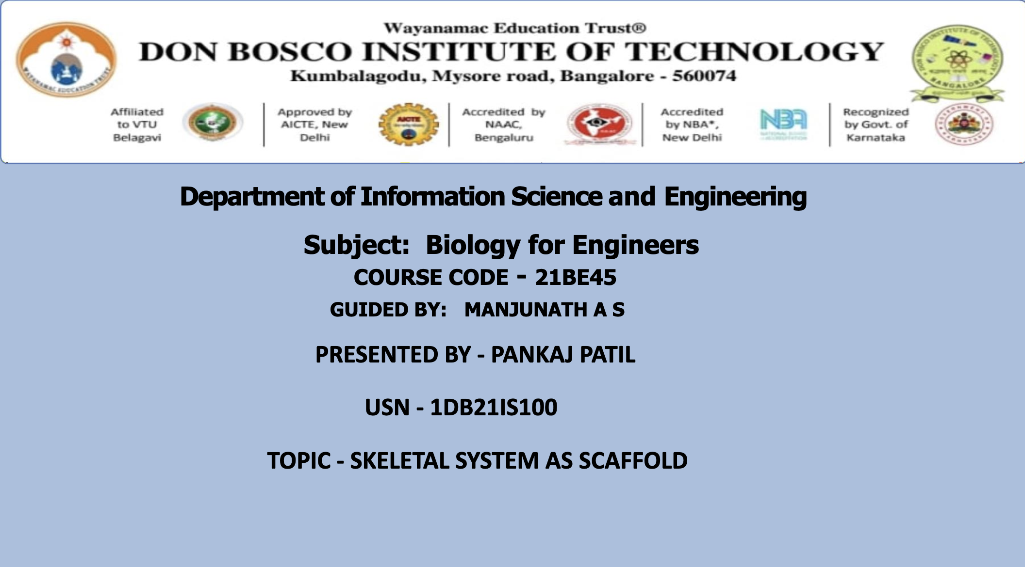

Slide 2
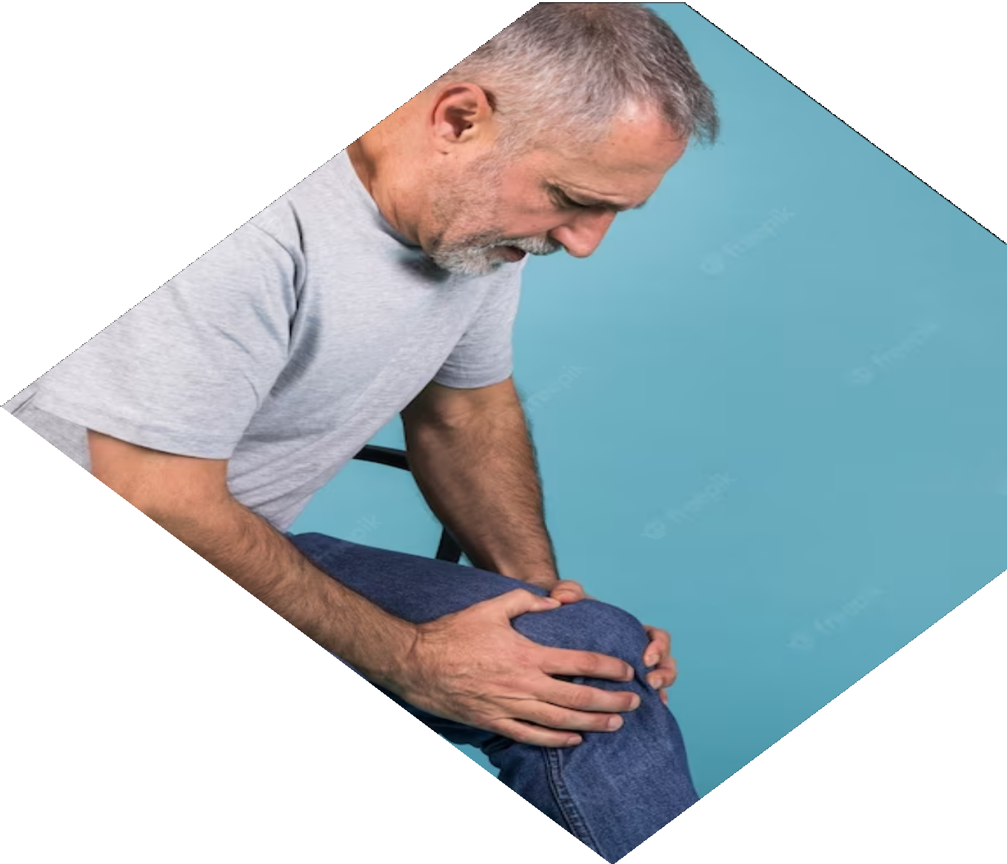
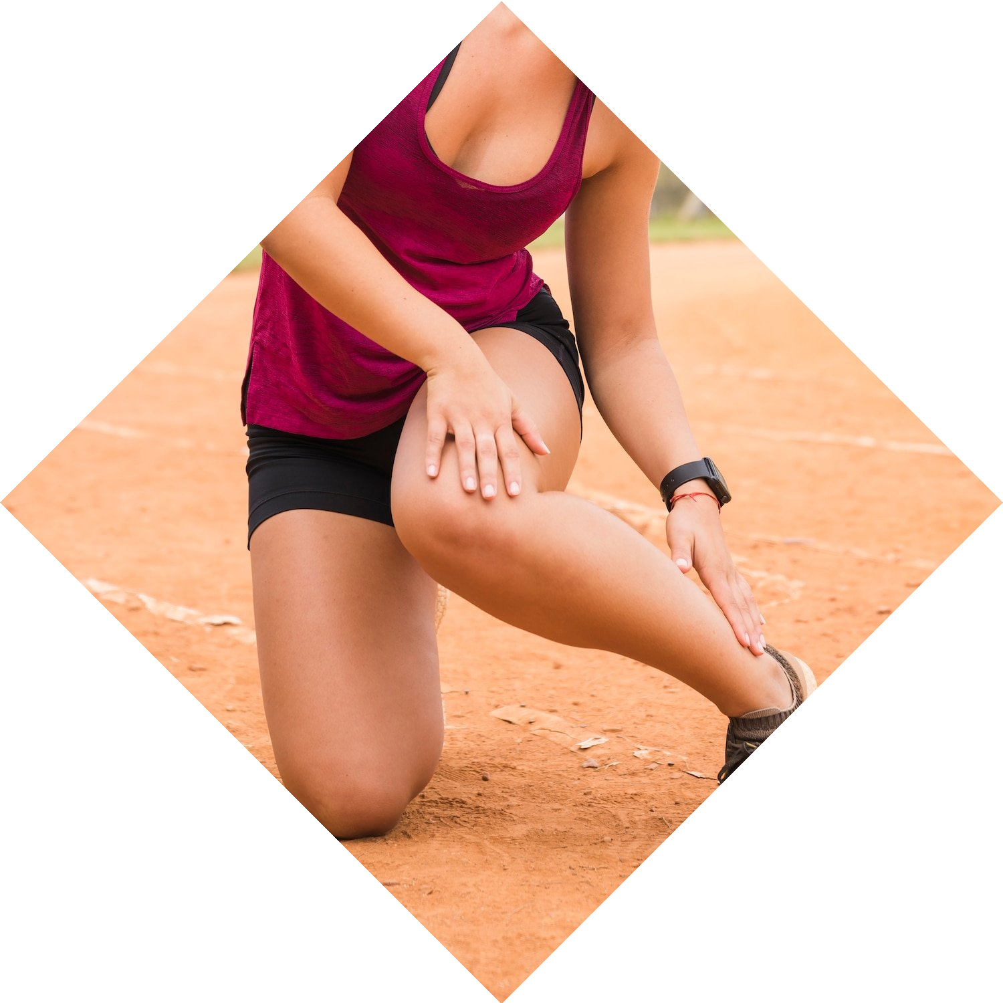
Building a Strong Foundation: The Skeletal System as a Vital Sca£old

Slide 3
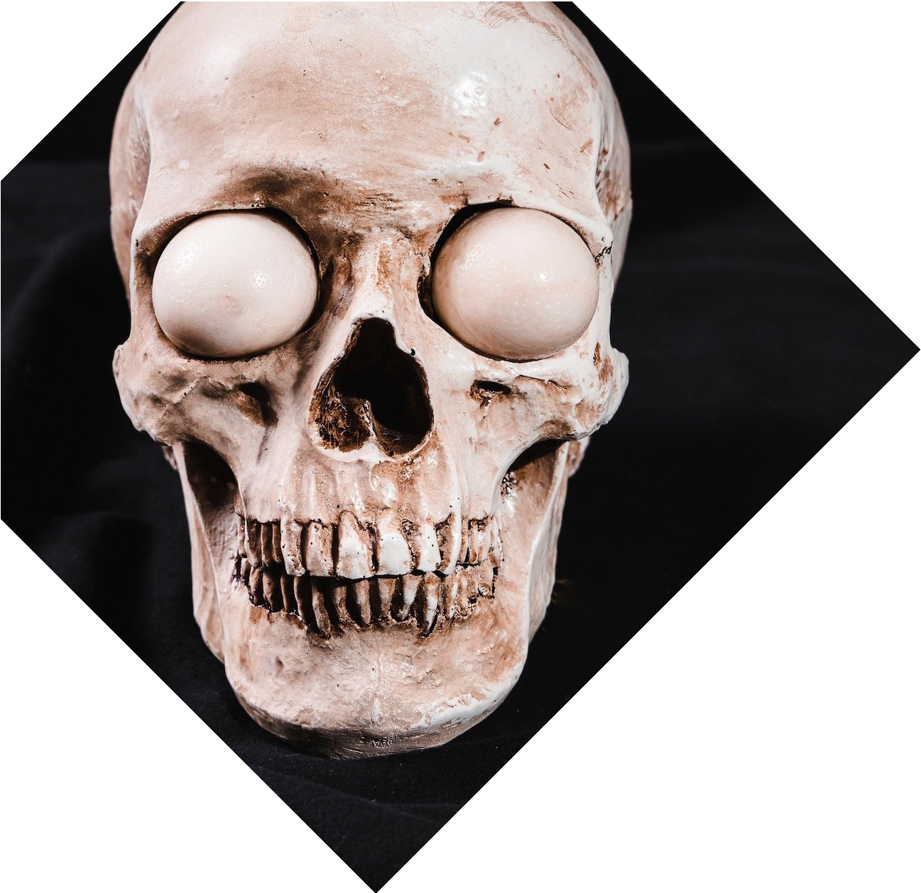

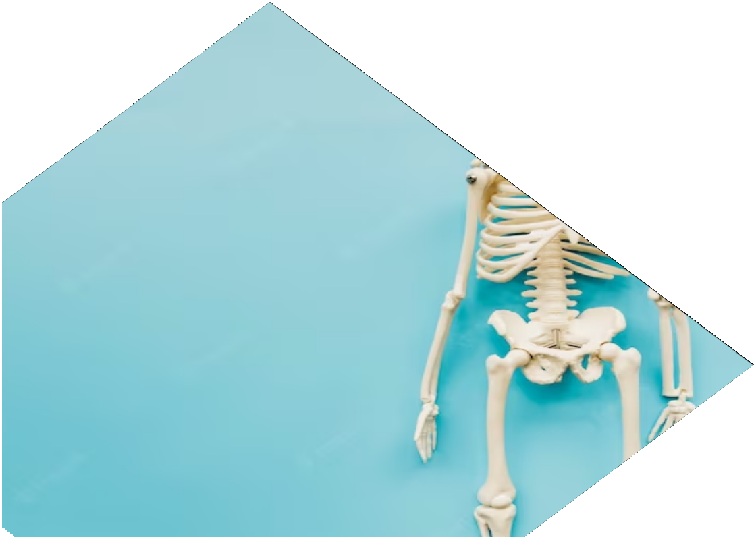
Introduction
The skeletal system is the foundation of the human body. It provides structural support, protects vital organs, and enables movement. This presentation will explore the importance of the skeletal system and how it functions as a vital scaffold.

Slide 4
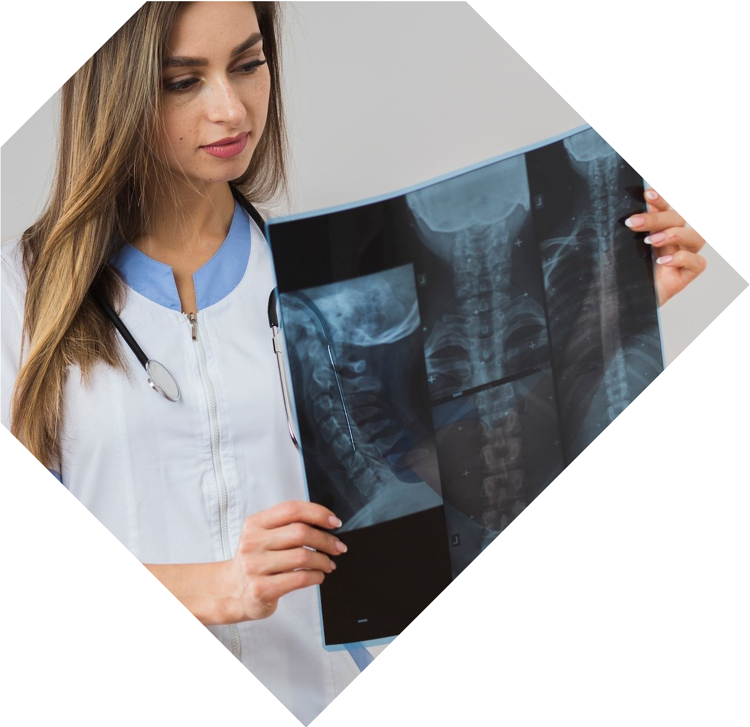
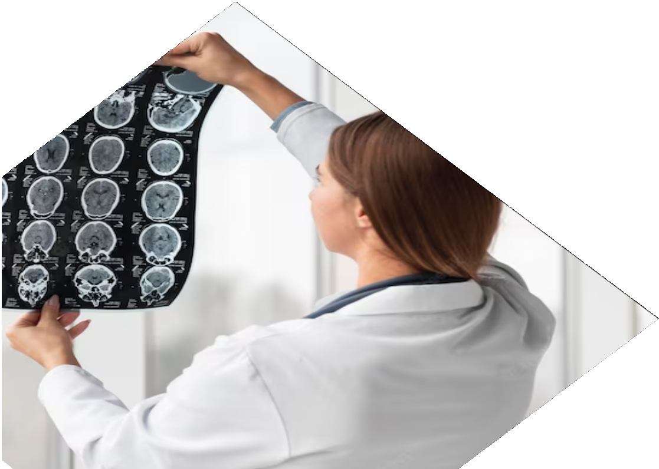
Bones
Bones are the building blocks of the skeletal system. They are made up of collagen and minerals, giving them strength and ﬂexibility. There are 206 bones in the human body, each with a unique shape and function. Bones also produce blood cells and store minerals like calcium and phosphorus.

Slide 5
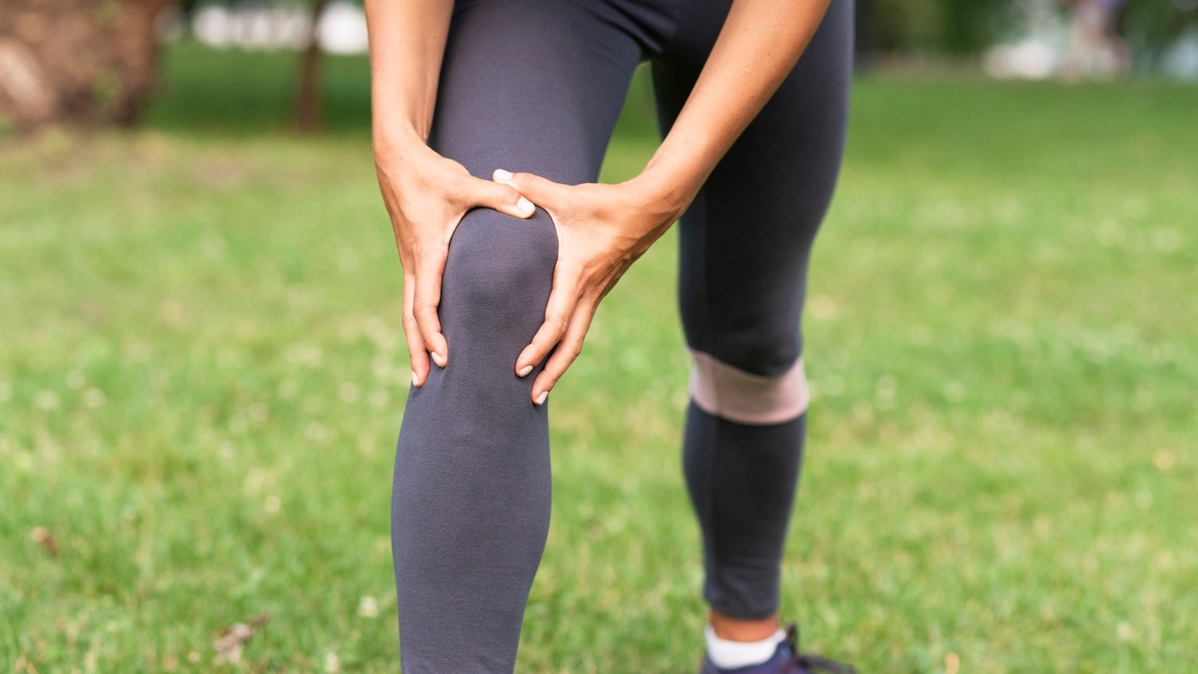
Joints
Joints are the points where two or more bones meet. They allow for movement and ﬂexibility, but also provide stability. There are different types of joints, including hinge, ball-and-socket, and pivot joints. Cartilage and synovial ﬂuid help cushion and lubricate joints.

Slide 6
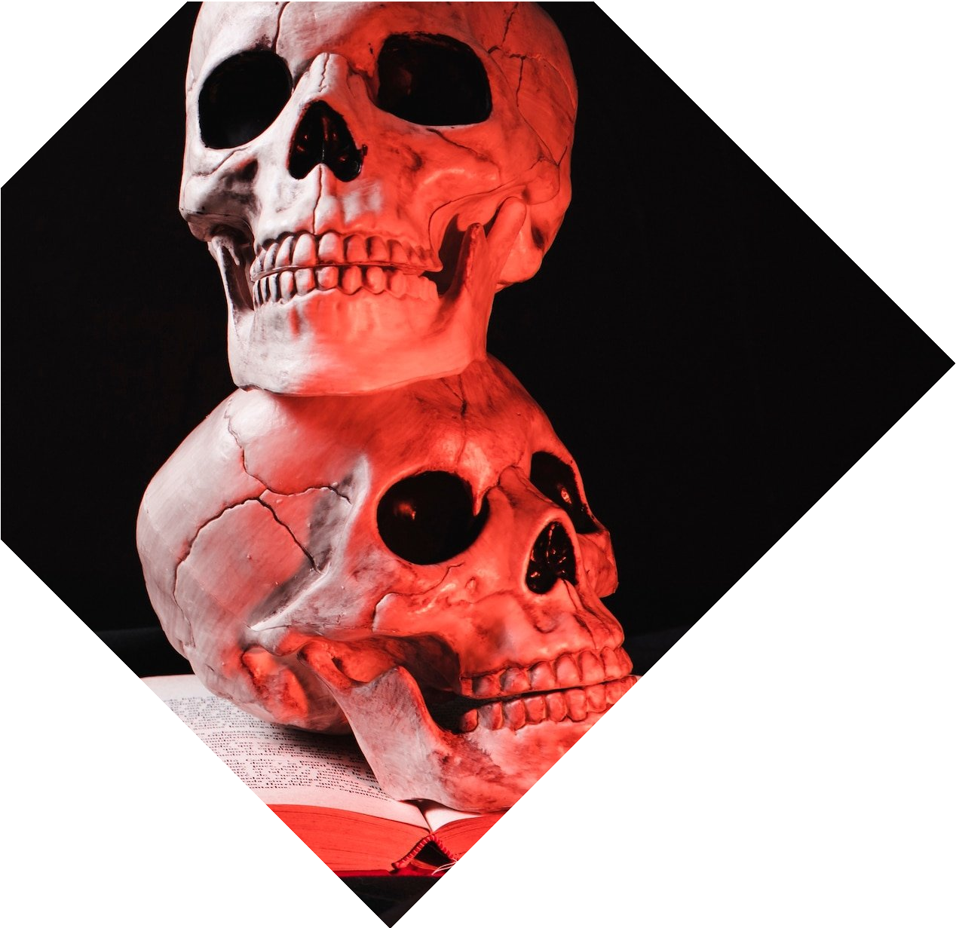
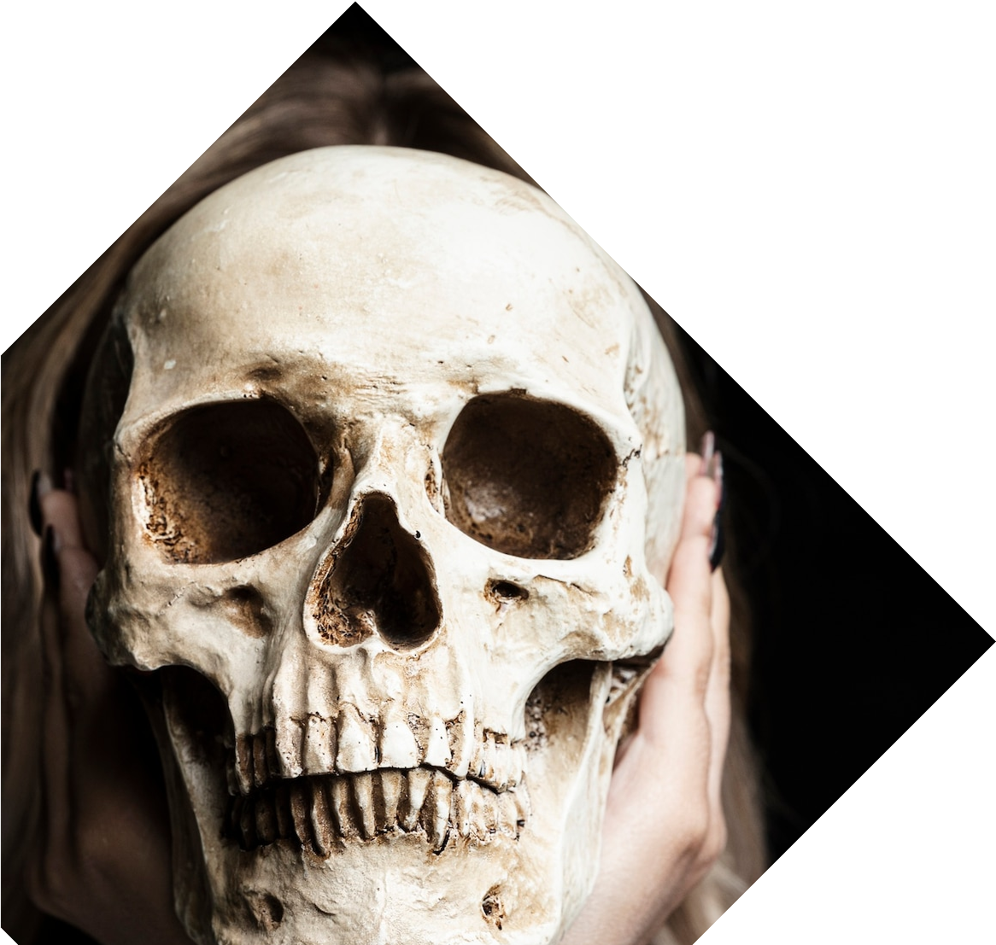
Axial Skeleton
The axial skeleton includes the skull, vertebral column, and ribcage. It protects vital organs like the brain, spinal cord, and heart. The skull also houses the sense organs like the eyes and ears. The vertebral column allows for movement and ﬂexibility, while the ribcage protects the lungs.

Slide 7
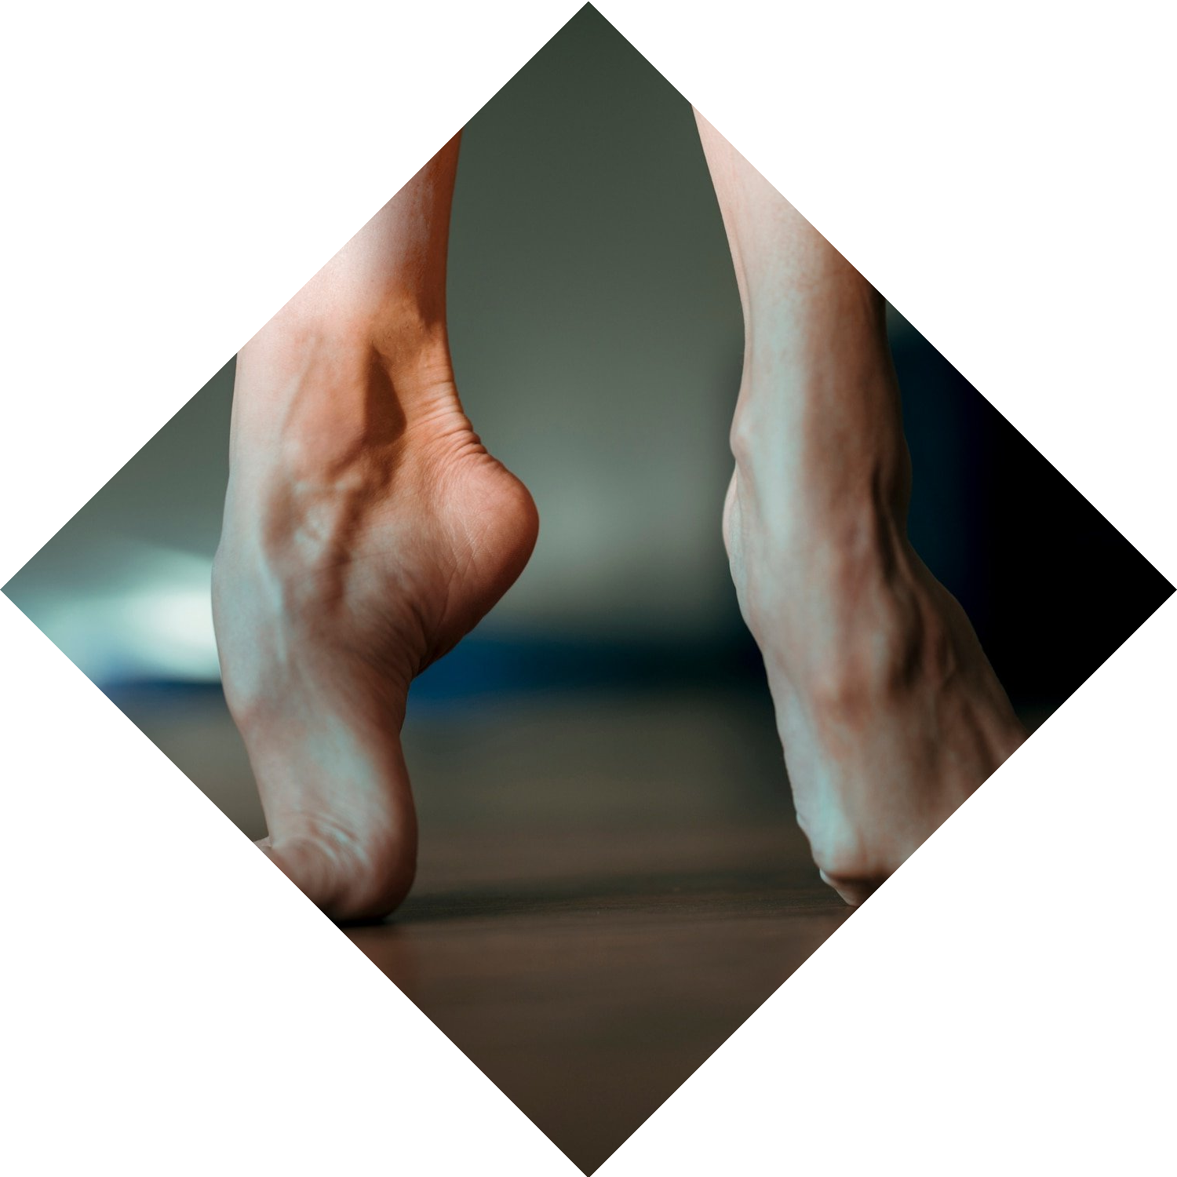
Appendicular Skeleton
The appendicular skeleton includes the limbs and their attachments to the axial skeleton. It allows for movement and locomotion. The upper limbs consist of the humerus, radius, ulna, carpals, metacarpals, and phalanges.
The lower limbs consist of the femur, tibia, ﬁbula, tarsals, metatarsals, and
phalanges.

Slide 8

Bone Growth
Bones grow and develop throughout childhood and adolescence. The growth plates at the ends of long bones are responsible for bone growth. Hormones like growth hormone and sex hormones play a role in bone growth and development.
Bone growth stops in early adulthood, but bones can still adapt and remodel
throughout life.

Slide 9
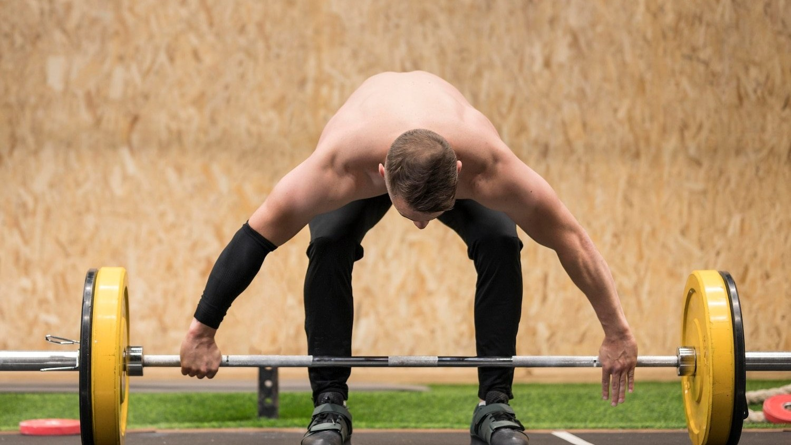
Bone Health
Bone health is important for overall health and well-being. A balanced diet with adequate calcium and vitamin D is essential for bone health. Weight-bearing exercise and physical activity are also important for maintaining bone density and strength. Certain medical conditions and medications can affect bone health.

Slide 10

Conclusion
The skeletal system is a vital scaffold that provides support, protection, and movement for the human body. Bones, joints, the axial skeleton, and the appendicular skeleton all work together to maintain the body's structure and function. Maintaining bone health through diet and exercise is essential for overall health and well-being.

Slide 11
Thanks!

